Slide 1
CTM 1A
Sections 14.4 Solving Equations with Rational Expressions

Slide 2
Rational Equations
When solving a equation with rational expressions it is possible to have solutions that will not check in the original equation. These solutions are called extraneous roots.
We start solving an equation with rational expressions by determining which values must be excluded as solutions.

Slide 3
Rational Equations
Excluded values are values that create a denominator of a rational expression to equal 0.
Set each denominator equal to 0 and solve each equation to determine the excluded values. (This calculation can often be completed using mental math)

Slide 4
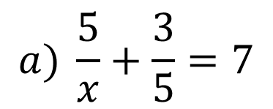
Rational Equations
Determine the value or values that must be excluded as possible solutions. (Examples)
$$a) \frac{5}{x}+\frac{3}{5}=7$$
Excluded (restricted) value is 0
$$x=0$$

Slide 5
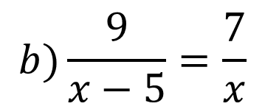
Rational Equations
Determine the value or values that must be excluded as possible solutions. (Examples)
$$b)\frac{9}{x−5}=\frac{7}{x}$$
Excluded (restricted) values are 0 and 5
$$x−5=0 or x=0$$
$$x=5$$

Slide 6
Rational Equations
Determine the value or values that must be excluded as possible solutions. (Examples)
$$c) \frac{4}{2x}+\frac{3}{x+5}=2$$
Excluded (restricted) values are 0 and - 5
$$2x=0 or x+5=0$$
$$x=0 or x=−5$$

Slide 7
Rational Equations
To solve an equation that contains rational expressions:
- determine the excluded values
- multiply every term in the equation by the LCM
of the denominators
- solve the resulting equation
- remove any excluded solutions
- check the remaining solutions

Slide 8
Rational Equations
To solve an equation that contains rational expressions:
- determine the excluded values

Slide 9
Rational Equations
To solve an equation that contains rational expressions:
- determine the excluded values
- multiply every term in the equation by the
LCM of the denominators

Slide 10
Rational Equations
To solve an equation that contains rational expressions:
- determine the excluded values
- multiply every term in the equation by the LCM
of the denominators
- solve the resulting equation

Slide 11
Rational Equations
To solve an equation that contains rational expressions:
- determine the excluded values
- multiply every term in the equation by the LCM
of the denominators
- solve the resulting equation
- remove any excluded solutions

Slide 12
Rational Equations
To solve an equation that contains rational expressions:
- determine the excluded values
- multiply every term in the equation by the LCM
of the denominators
- solve the resulting equation
- remove any excluded solutions
- check the remaining solutions

Slide 13
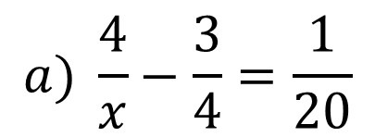
Rational Equations
Solve each equation. (Examples)
$$a) \frac{4}{x}−\frac{3}{4}=\frac{1}{20}$$
$$LCD=20x$$
$$Restricted value: 0$$
$$5$$
$$\frac{4}{x}∙\frac{20x}{1}−\frac{3}{4}∙\frac{20x}{1}=\frac{1}{20}∙\frac{20x}{1}$$
$$80$$
$$−15x$$
$$=x$$
$$80=16x$$
$$5=x$$

Slide 14
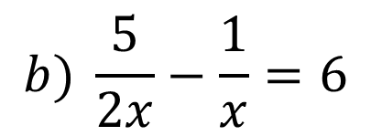
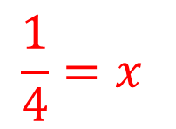
Rational Equations
Solve each equation. (Examples)
$$LCD=2x$$
$$b) \frac{5}{2x}−\frac{1}{x}=6$$
$$Restricted value: 0$$
$$\frac{5}{2x}∙\frac{2x}{1}−\frac{1}{x}∙\frac{2x}{1}=6∙\frac{2x}{1}$$
$$\frac{1}{4}=x$$
$$5$$
$$−2$$
$$=12x$$
$$3=12x$$

Slide 15
Rational Equations
Solve each equation. (Examples)
$$LCD=(x+5)(x−5)$$
$$c) \frac{10}{x+5}=\frac{1}{x−5}−\frac{2}{x+5}$$
$$Restricted values: −5 and 5$$
$$\frac{10}{x+5}∙\frac{\left(x+5\right)\left(x−5\right)}{1}=\frac{1}{x−5}∙\frac{\left(x+5\right)\left(x−5\right)}{1}−\frac{2}{x+5}∙\frac{\left(x+5\right)\left(x−5\right)}{1}$$
$$10(x−5)$$
$$=1(x+5)$$
$$−2(x−5)$$
$$10x−50=x+5−2x+10$$

Slide 16
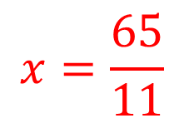
Rational Equations
Solve each equation. (Examples)
$$LCD=(x+5)(x−5)$$
$$c) \frac{10}{x+5}=\frac{1}{x−5}−\frac{2}{x+5}$$
$$Restricted values: −5 and 5$$
$$10x−50=x+5−2x+10$$
$$10x−50=−x+15$$
$$11x=65$$
$$x=\frac{65}{11}$$

Slide 17
Rational Equations
Determine the value or values that must be excluded as possible solutions. (Skill Check)
$$a) \frac{6}{x}+5=\frac{5}{12} x≠0$$
$$b) \frac{15}{2x}=\frac{6}{x+9} x≠0 and x≠−9$$

Slide 18
Rational Equations
Determine the value or values that must be excluded as possible solutions. (Skill Check)
$$c) \frac{1}{9x}+\frac{8x}{5x+15}=11 x≠0 and x≠−3$$
$$d) \frac{9}{x−2}+\frac{5}{x+2}=\frac{1}{x^{2}−4} x≠2 and x≠−2$$

Slide 19
Rational Equations
Solve each equation. (Skill Check)
$$a) \frac{6}{7}+\frac{5}{x}=1 x=35$$
$$b) \frac{2}{x}+\frac{5}{2x}−\frac{1}{2}=4 x=1$$

Slide 20
Rational Equations
Solve each equation. (Skill Check)
$$c) \frac{2}{x−3}+\frac{7}{x+3}=\frac{12}{x−3} x=−17$$

Slide 21
Rational Equations
Determine the second resistance, $R_{2}$, given that first resistance, $R_{1}$, is $10Ω$ and the total resistance, $R_{T}$, is $3.75 Ω$. (Skill Check)
$$R_{2}=\frac{R_{1}∙R_{2}}{R_{1}+R_{2}} R_{2}=6 Ω$$

